Slide 1
COMPUTER VISION FOR
WETLAND IDENTIFICATION
Citywide Analytics Team,
Department of Innovation and Technology
Brinda Sapra
Data Science Fellow, Coding It Forward
Notes:
Hi everyone. I am Brinda - I am a Data Science fellow. I’ve tried to structure the presentation keeping mind different technical experiences of all the stakeholders in this call so just a heads-up, if I am going too fast or too slow, please bear with me.
First, I want to take a minute to thank the key stakeholders I’ve been interacting with over the past 3 months.
Coding it forward team - for connecting me with the city of Boston and helping me troubleshoot various issues during the project.
Jeff and Daniel - for indulging my various questions to better understand the scope of the project.
Nicholas and Kathereine - for our Tuesday check-in calls where I could share my progress and gather feedback.

Slide 2



MOTIVATION
Wetlands are capable of mitigating three major types of climate risks that Boston is facing: extreme heat, stormwater flooding, and coastal and riverine flooding.
The Environment Department wants to use predictive analytics to identify wetlands in Boston.
Predictions will complement the Department’s efforts to prioritize their resources by identifying likely wetland locations to validate through in-person, expert inspection.
Notes:
The motivation behind this project was that city of Boston is facing climate related issues, such as extremely hot weather and risk of flooding, all of which can be mitigated by a natural resource present in the city, the wetlands!
The Environment Department wanted to use image data of the city to identify wetlands in Boston.
The goal is to identify wetlands for better planning of resources by the city and the residents. The intention to use machine learning was to eventually reduce the resources allocated to aerial surveys and in-person surveys

Slide 3
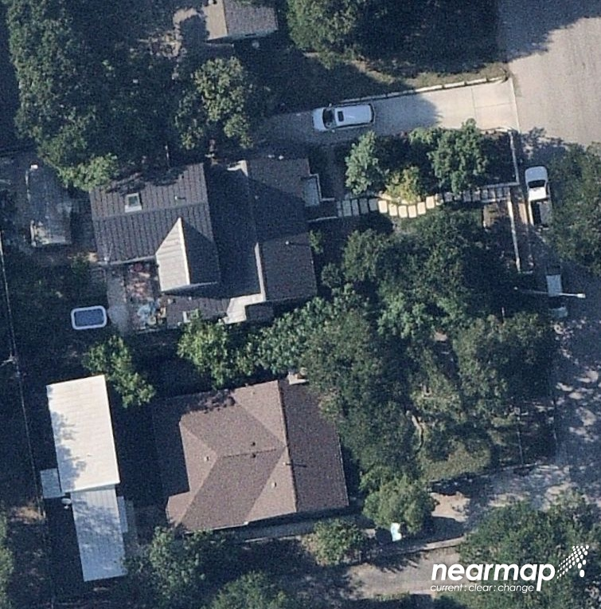
PROBLEM STATEMENT
Use satellite images to identify the presence of wetlands
Nearmap
Application of Computer Vision
Train a machine learning model to predict whether an image contains a wetland or not
(a.k.a binary image classification)
2 class labels: “Wetland” or “Nonwetland”
Notes:
So the primary objective was to use satellite images of Boston to train a machine learning model that can identify whether an image contains a wetland or not. This is a textbook case of binary classification where each image would be labelled as a WETLAND or NONWETLAND.

Slide 4
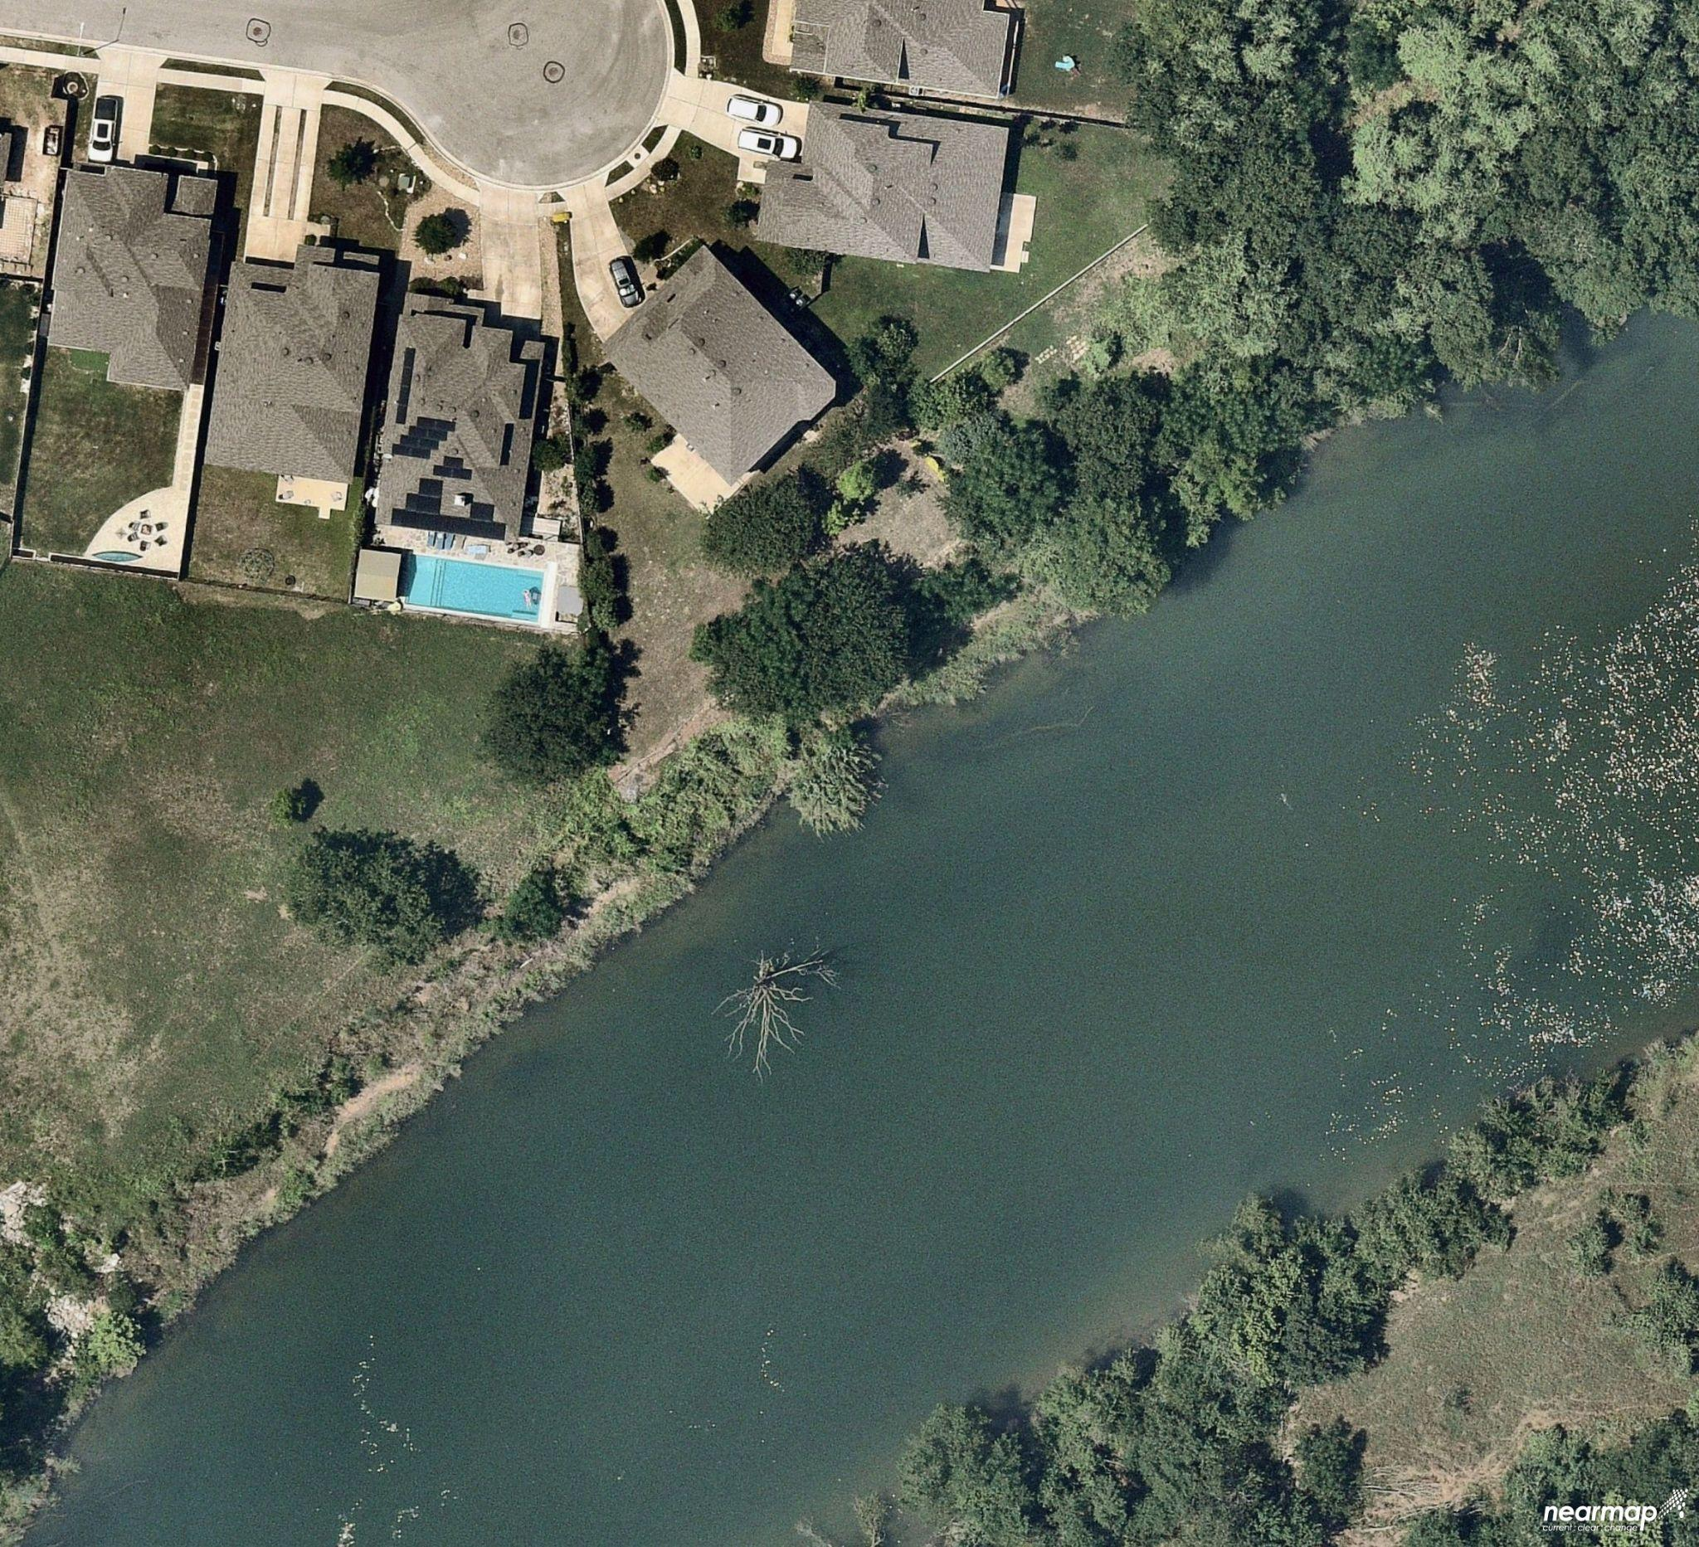
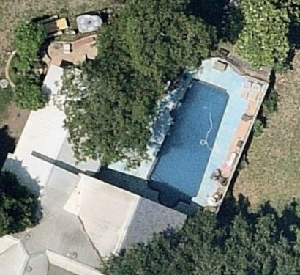


DEFINE WETLANDS
Any natural water bodies
Like lakes, ponds, river
Excluding swimming pools (human-made water bodies)
Notes:
The model is trained to interpret a wetland as natural waterbody like lakes, ponds, rivers etc
Human-made water bodies in images, like swimming pools, are considered as “Non-wetlands”
Red cross type of images with swimming pool should be used in model training and should be labelled as Non-wetland

Slide 5


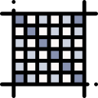





MACHINE LEARNING FOR IMAGE CLASSIFICATION PIPELINE
Source images from nearmap (wetlands & non-wetlands).
NOTE: ensure balanced dataset
Image pre-processing
Convert image to numeric data (vector of pixels)
Split image dataset: train-test (80-20)
Predict an image outside train-test data as wetland or non-wetland
Save the best model (maximum correct predictions)
Test ML model’s correct v/s incorrect predictions
Train ML model on images of wetlands and non-wetlands
Notes:
Although this is super basic, I thought its spending a minute on the overall structure of an ML data pipeline for an image classification model.
I sourced images from nearmap website which stores satellite image data for the map of Boston. I gather around 368 images, with 180 images of Wetlands and 188 of Nonwetlands. Since every class label is equally represented in my data, I have whats called a balanced dataset which is ideal for training a classification model.
Pre-processing every image to augment the size of the dataset and make the model learn different varieties of the same image - eg flipping an image horizontally, vertically, cropping it, blurring it out etc
Convert each image into numeric data because a model cannot understand anything other than numbers. So extracting pixels out of the image.
Split 368 images such that 80% of them are used for training the model about difference between what is a wetland v/s non-wetland. Remaining 20% are used to test whether the model correctly learnt the differences between 2 classes.
I create several different versions of the 80-20 split and for each of them I check the model’s correct predictions. Ultimately, I store the mode with the highest correct predictions.
Then I designed a web-interface to serve the ML model as a demo where I can simply drop an image and see the probability of the image being a Wetland or Nonwetland. Next slide has a small gif/video of the same

Slide 6
WETLAND
IDENTIFICATION DEMO

Slide 7
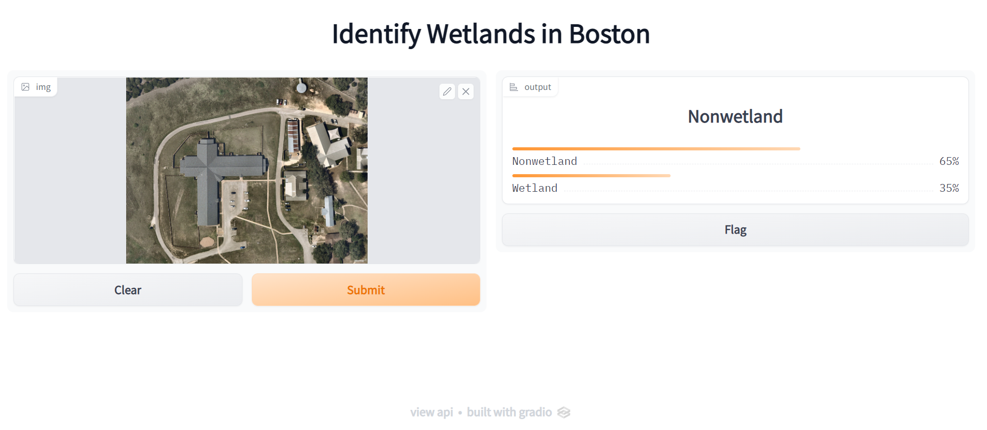

Slide 8
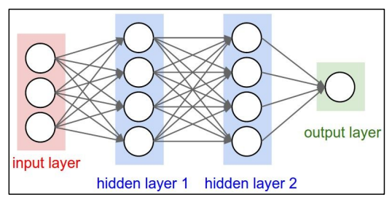

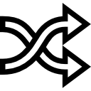


CONVOLUTIONAL NEURAL NETWORK (CNN) - I
CNNs are a type of deep learning model that are used for computer vision applications
Common applications of CNN:
Image Classification
Image Recognition
Object Detection
What is Deep Learning?
Loop for each “batch” of images
Sample a
batch of
images
Initialise weights & biases for each neuron
Pass images in network & predict. Find prediction error.
Based on error/residual, update parameters to min. error
Notes:
Conv neural networks are a type of deep learning model that is used for computer vision applications like image classification and object detection. I thought its worth spending a minute on understanding at a high level how a deep learning model operates under the hood. This is an image of a deep neural network which has an input layer with many neurons represented by the circles, has 2 hidden layers, and a final output layer which spits out the prediction. Every hidden layer is responsible for detecting different edges of an image by using the pixel values.
Create batches of the entire dataset, eg. each batch will contain 25 images
Consider first batch of 25 images
Each neuron in the entire network is associated with a weight and a bias parameter (similar to slope and intercept terms in a linear regression). These are parameters that are learnt during the model training. But when the neural network is being created, parameter values are randomly initialised.
Now pass the entire batch of 25 images through the network so weights and biases will applied on them and accordingly, prediction will be made. Then we will compare the prediction with the ground-truth label. Based on the number of errors made by the model, the model will adjust its parameter and keep repeating this process of finding prediction errors and updating parameters until the errors are minimized.
Then we repeat this in a loop for all batches of 25 images.
Weights and biases are parameters which are similar to slope and intercept values in a linear regression model
https://www.slideshare.net/SurajKumar346/convolution-neural-network-cnn
http://cs231n.stanford.edu/slides/2016/winter1516_lecture7.pdf

Slide 9
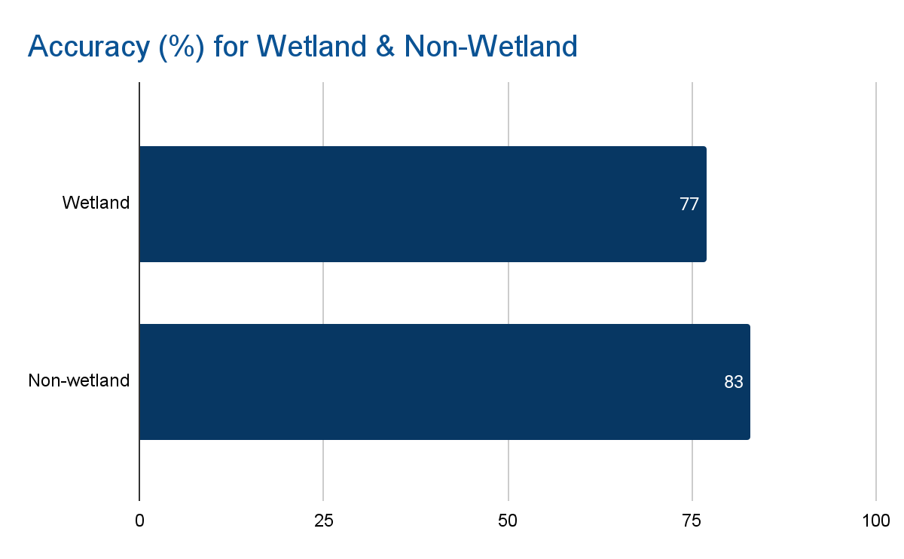
MODEL PERFORMANCE
Model performance is evaluated by using a common metric called Accuracy for each class label
Wetlands Identification model has 2 class labels: 1) Wetland, 2) Non-wetland
Prediction Accuracy for “Wetland” class
100 x (Number of correct predictions for Wetland / Total Wetland images)

Slide 10
PREDICTING WETLANDS ROADMAP: NEXT STEPS
Integrate model’s predictions with the Environment Department’s work for resource allocation on identifying wetlands
Tune hyper-parameters (eg. number of layers, dimensions of each layer, epochs) to improve current model’s prediction accuracy
K-fold cross-validation to reduce over-fitting (improve model’s ability to generalise its learnings on new images)
Code provided, need to just run it!

Slide 11
THANK YOU!
Notes:
Appendix has some slides explaining a high-level overview of the mechanism and intuition underlying a Convolutional Neural Network model

Slide 12
APPENDIX
Source: Stanford Lecture Slides, Towards Data Science
Notes:
Source: http://cs231n.stanford.edu/slides/2016/winter1516_lecture7.pdf

Slide 13
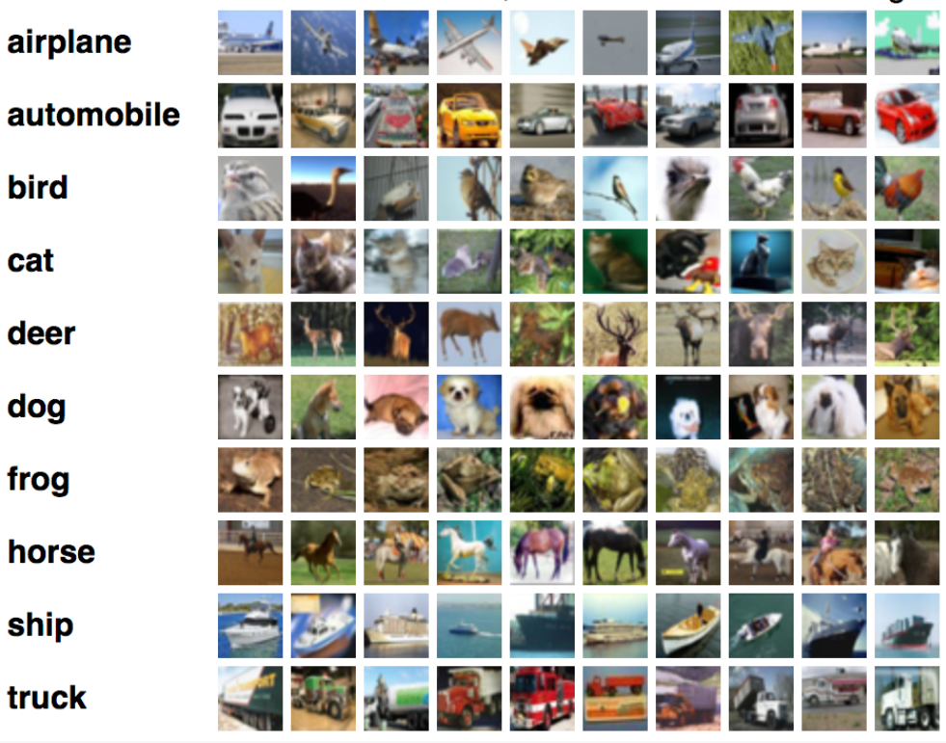
APPLICATIONS OF CNN
Image Classification
Classify an entire image into a class label

Slide 14
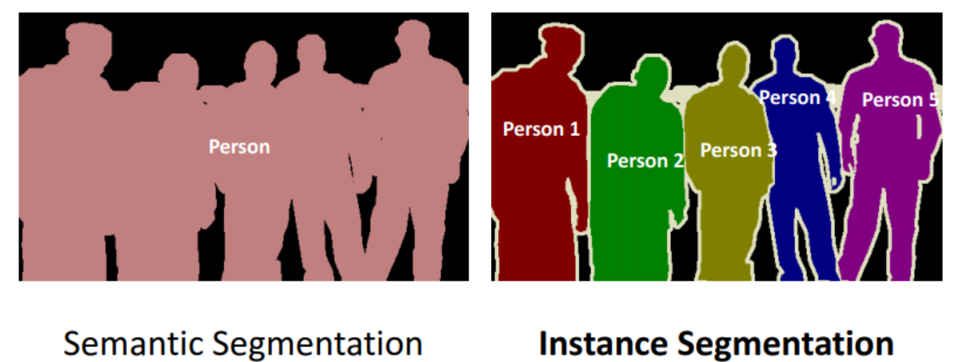
APPLICATIONS OF CNN
Image Segmentation
Partitioning an image into multiple segments and then analysing the pixels
Semantic Segmentation
Task of assigning a class to every pixel in a given image.
Different from image classification which assigns a class to an entire image.
Example - self driving vehicles use this to navigate route
Instance Segmentation
Different instances of the same class are segmented individually in instance segmentation.

Slide 15
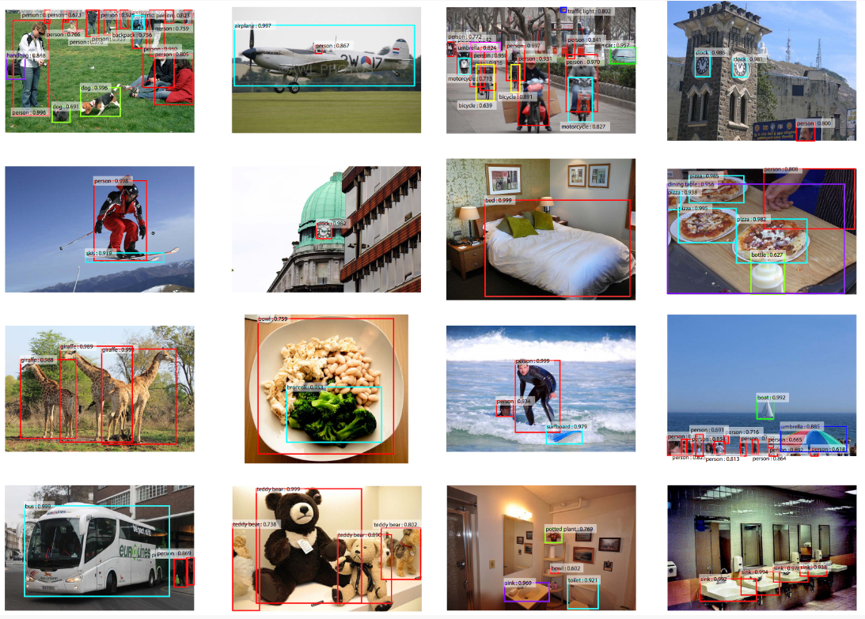
APPLICATIONS OF CNN
Image Recognition
Detect the object, classify it and then recognize it
Face Recognition - first detect the face in the image scanned by your phone, then classify it as human fae, then it matches the image with the face of the owner’s image
Amazon, employs CNN for image recognition to make suggestions in the “you might also like” area. The presumption is based on the user’s expressed behavior. The products are matched based on visual criteria, such as red shoes and red lipstick for a red outfit.

Slide 16
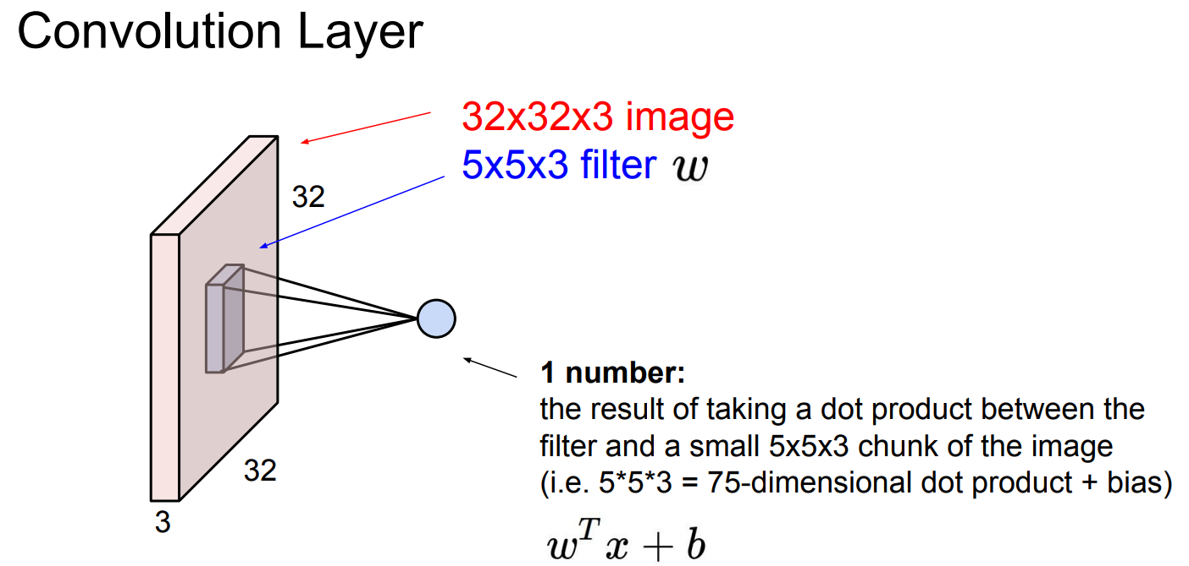
CONVOLUTIONAL NEURAL NETWORK (CNN) - II
Notes:
CNN made of 3 layers in repetition: 1) Convolution layer, 2) Pooling layer, 3) Fully connected layer
Consider an image has dimensions 32x32x3 =Length x Width x Depth. The goal is to condense this image into an image of smaller dimensions. This happens through “convolving” a filter, with the image. A filter is a matrix of smaller dimension than the image, which is spatially moved across different parts of the image and a dot product is taken between the matrix filter and matrix image pixels.

Slide 17
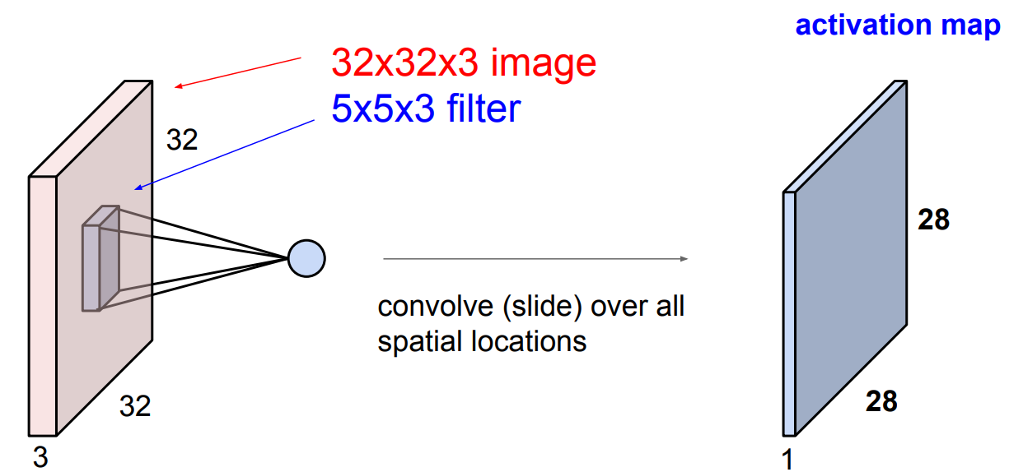
CONVOLUTIONAL NEURAL NETWORK (CNN) - II
Notes:
Consider an image has dimensions 32x32x3 =Length x Width x Depth. The goal is to condense this image into an image of smaller dimensions. This happens through “convolving” a filter, across the image. A filter is a matrix of smaller dimension than the image, which is spatially moved across different parts of the image and a dot product is taken between the matrix filter and matrix image pixels, after every “stride”.
This convolution of filter across input image results in a new matrix which has smaller dimensions 28 x 28 x 1 – this is called Activation Map.

Slide 18
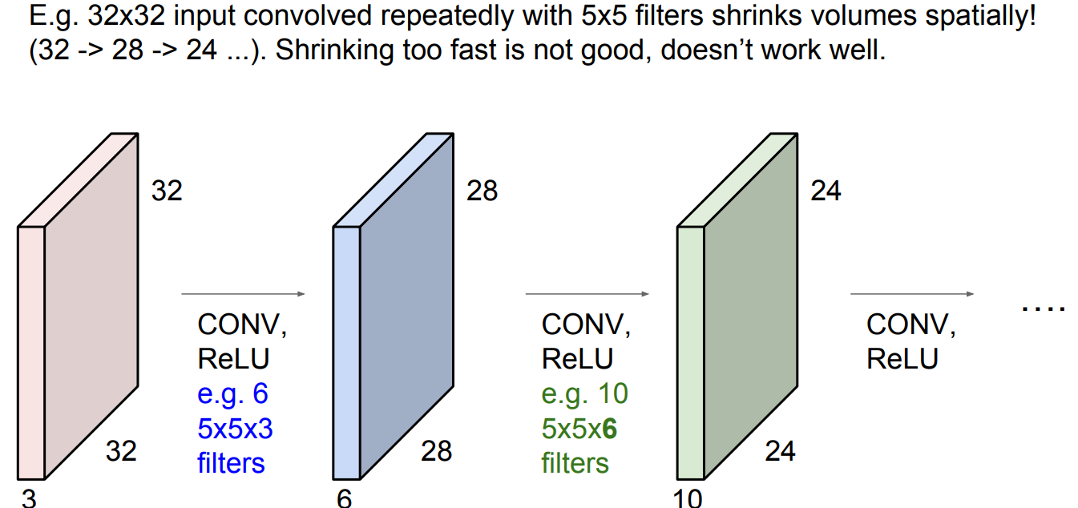
CONVOLUTIONAL NEURAL NETWORK (CNN) - III
Notes:
Consider an image has dimensions 32x32x3 =Length x Width x Depth. This is called the Convolution Layer. The goal is to condense this image into an image of smaller dimensions. This happens through “convolving” a filter, across the image. A filter is a matrix of smaller dimension than the image, which is spatially moved across different parts of the image and a dot product is taken between the matrix filter and matrix image pixels, after every “stride”.
This convolution of filter across input image results in a new matrix which has smaller dimensions 28 x 28 x 1 – this is called Activation Map. The first Activation Map becomes the 2nd convolution layer, along which the filter is convolved. Then same process as in slide 16, will happen with this 2nd convolution layer
The shrinking keeps happening with subsequent convolutions (Conv) interspersed with activation functions (ReLu) and some other techniques of “downsampling” like max-pooling.

Slide 19
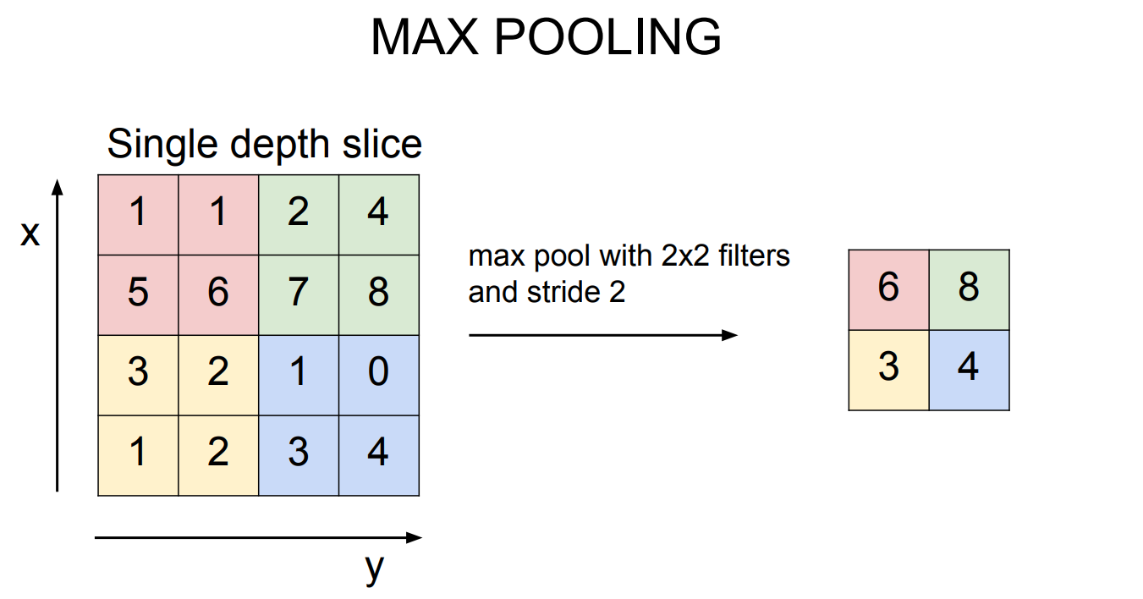
CONVOLUTIONAL NEURAL NETWORK (CNN) - IV
Notes:
Consider an image has dimensions 32x32x3 =Length x Width x Depth. This is called the Convolution Layer. The goal is to condense this image into an image of smaller dimensions. This happens through “convolving” a filter, across the image. A filter is a matrix of smaller dimension than the image, which is spatially moved across different parts of the image and a dot product is taken between the matrix filter and matrix image pixels, after every “stride”.
This convolution of filter across input image results in a new matrix which has smaller dimensions 28 x 28 x 1 – this is called Activation Map. The first Activation Map becomes the 2nd convolution layer, along which the filter is convolved.
The shrinking keeps happening with subsequent convolutions (Conv) interspersed with activation functions (ReLu) and some other techniques of “downsampling” like max-pooling.
In above example, we consider max pool with 2x2 filter and stride=2. Means at a time, we consider 2x2 cells -> find max number -> store in a new cell. Then take 2 steps to the right because stride=2, and again find max of those 2x2 cells. Then bottom stride=2, repeat. This forms a new matrix of 2x2, reduced from original matrix of size 4x4. Then apply convolution layer, activation layer and max pooling layer on this smaller matrix of 2x2.

Slide 20
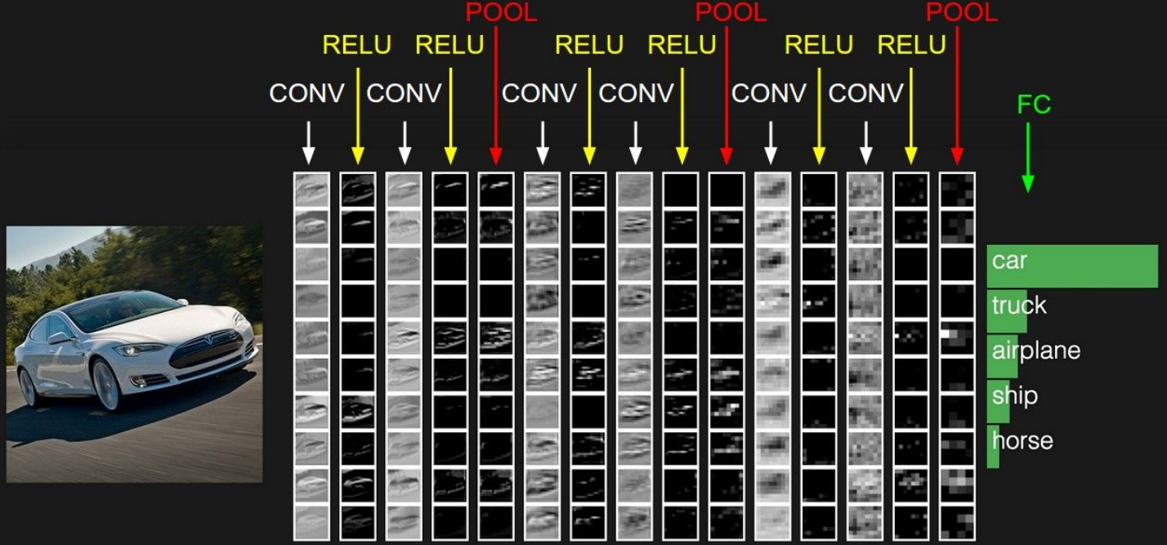
CONVOLUTIONAL NEURAL NETWORK (CNN) - V
Notes:
Consider an image has dimensions 32x32x3 =Length x Width x Depth. This is called the Convolution Layer. The goal is to condense this image into an image of smaller dimensions. This happens through “convolving” a filter, across the image. A filter is a matrix of smaller dimension than the image, which is spatially moved across different parts of the image and a dot product is taken between the matrix filter and matrix image pixels, after every “stride”.
This convolution of filter across input image results in a new matrix which has smaller dimensions 28 x 28 x 1 – this is called Activation Map. The first Activation Map becomes the 2nd convolution layer, along which the filter is convolved.
The shrinking keeps happening with subsequent convolutions (Conv) interspersed with activation functions (ReLu) and some other techniques of “downsampling” like max-pooling. In above example, we consider max pool with 2x2 filter and stride=2. Means at a time, we consider 2x2 cells -> find max number -> store in a new cell. Then take 2 steps to the right because stride=2, and again find max of those 2x2 cells. Then bottom stride=2, repeat. This forms a new matrix of 2x2, reduced from original matrix of size 4x4. Then apply convolution layer, activation layer and max pooling layer on this smaller matrix of 2x2.
When we have reached the last stage of CNN, it is called a Fully Connected Layer (FC) where the maximum number in final matrix represents a class label, here 8 represents a car. Hence in next slide, car has highest probability of being the class label.

Slide 21
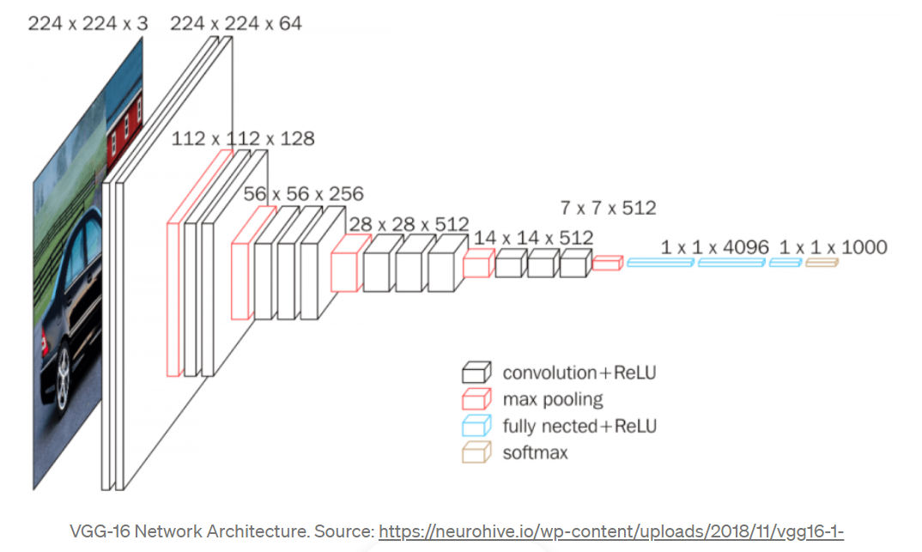
CONVOLUTIONAL NEURAL NETWORK (CNN) - VI
Notes:
Source: https://towardsdatascience.com/an-introduction-to-convolutional-neural-networks-eb0b60b58fd7
Note the dimensions of the image shrinking from 224 x 224 x 3 to 1 x 1000. This is for a pre-trained model VGG. The model used in my code has a different architecture i.e. ResNet34 model. But underlying intuition of CNN remains the same. My model would have a fully connected layer and softmax layer of 1x2 instead of 1x1000 because the wetland model has only 2 class labels, not 1000 class labels unlike in the above example.

